Slide 1

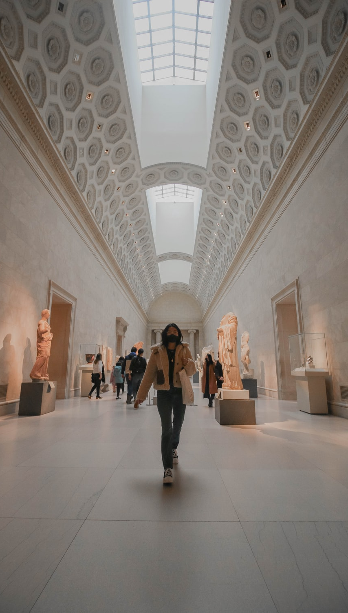
Mobile application to scan and Extract historically and architecturally accurate data of an archaeological object
This presentation highlights a cutting-edge mobile application designed for archaeological research. It uses advanced image processing, machine learning, and 3D reconstruction to accurately scan and analyze artifacts, improving historical and architectural insights while addressing key challenges in object recognition and data retrieval.

Slide 2
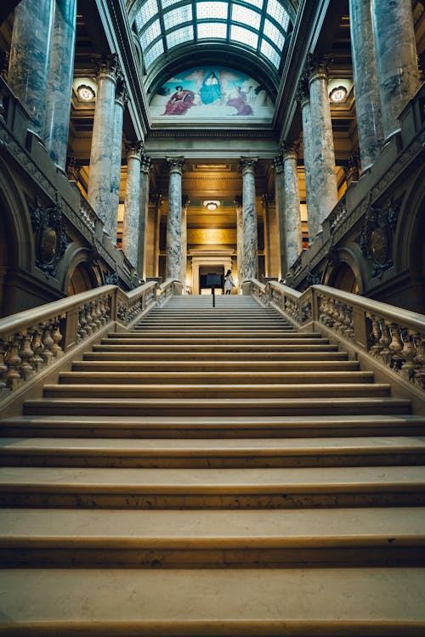
Introduction
study of archaeological objects are crucial for understanding human history and cultural heritage. However, traditional methods of documenting and analyzing these artifacts are often time-consuming, require specialized equipment, and can be prone to human error. Advances in mobile technology and machine learning offer a promising solution to these challenges. This research aims to develop a mobile application capable of scanning and extracting historically and architecturally accurate data from archaeological objects.

Slide 3


IT21344824 | T.E.M.A.P. Ekanayake
Specialization : Information Technology
IT21344824 | T.E.M.A.P. Ekanayake | 24-25J-092
13/8/2024

Slide 4
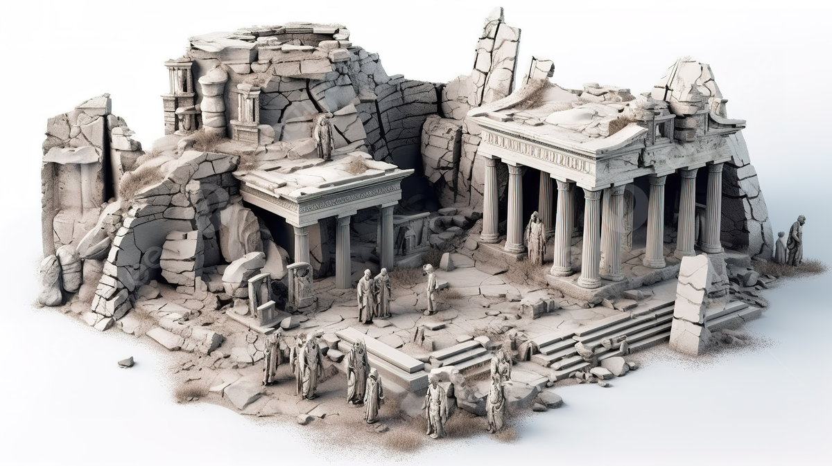
3D Object prompt generation
IT21344824 | T.E.M.A.P. Ekanayake | 24-25J-092
13/8/2024

Slide 5
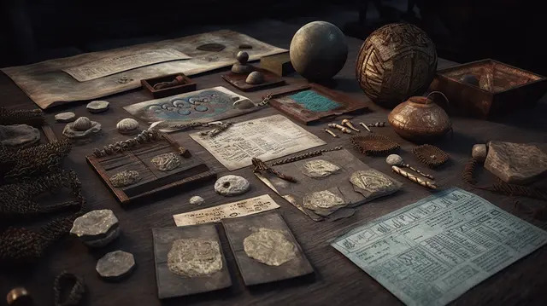
Introduction
The preservation and study of archaeological objects are essential for understanding human history and cultural heritage.
Traditional methods of documenting and analyzing these artifacts are often time-consuming,
the ability to generate accurate 3D models from 2D images, which can significantly enhance the analysis and preservation of archaeological objects.
It’s more detailed and comprehensive making it more understanding of archaeological artifacts
IT21344824 | T.E.M.A.P. Ekanayake | 24-25J-092
13/8/2024

Slide 6
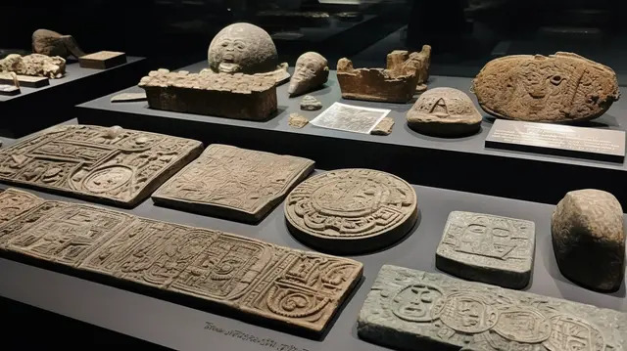
Introduction
Challenges:
Texture Mapping - Preserving the surface details and textures of the archaeological objects
Optimization for Mobile Devices - more helpful for archaeologist
Image Quality and Preprocessing- accuracy of the 3D models generated
IT21344824 | T.E.M.A.P. Ekanayake | 24-25J-092
13/8/2024

Slide 7
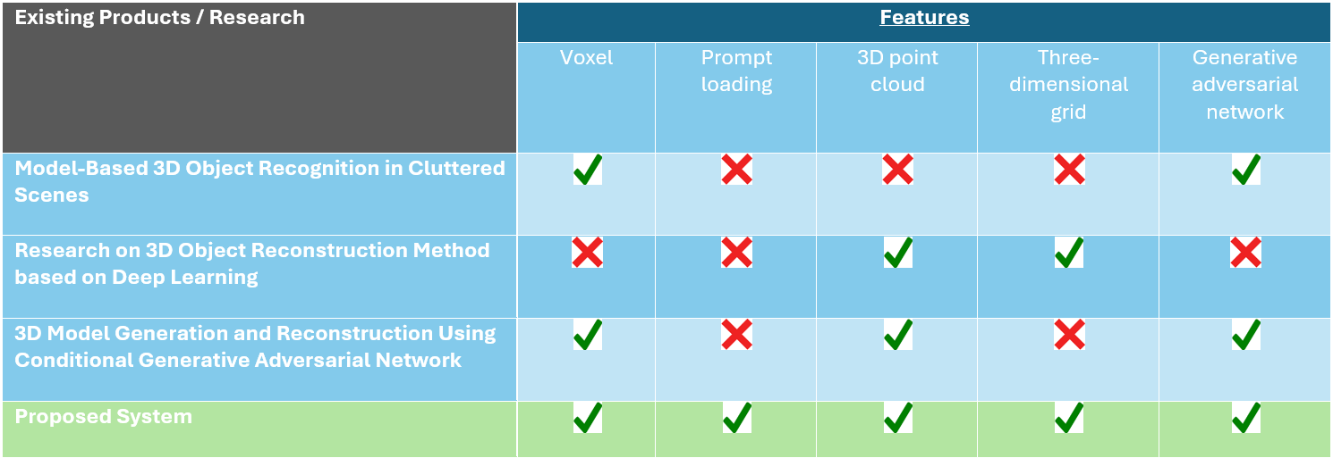
Research Gap
IT21344824 | T.E.M.A.P. Ekanayake | 24-25J-092
13/8/2024

Slide 8
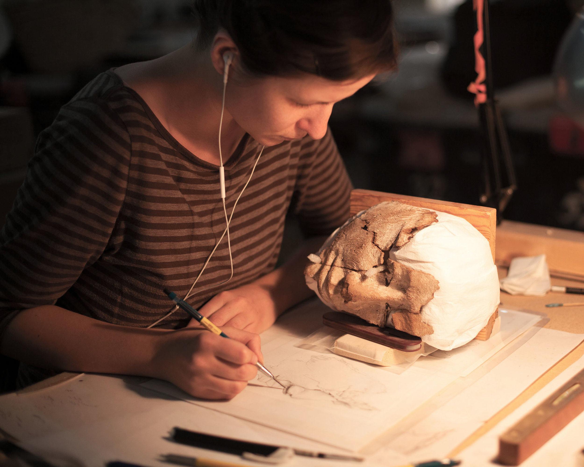
Research Question
How to generate precise and detailed 3D models of archaeological objects from 2D images using mobile applications?
IT21344824 | T.E.M.A.P. Ekanayake | 24-25J-092
13/8/2024

Slide 9
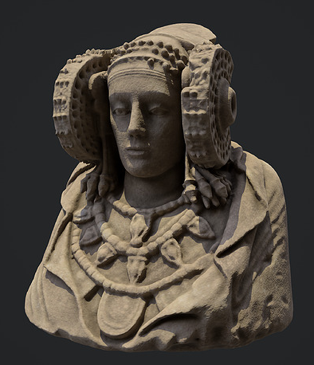
Specific & Sub Objectives
Specific Objective
Develop algorithms to convert 2D images into accurate 3D models of archaeological objects.
Sub Objective
Implement texture mapping to preserve the object's surface details.
Optimize the 3D generation process for mobile devices.
IT21344824 | T.E.M.A.P. Ekanayake | 24-25J-092
13/8/2024

Slide 10
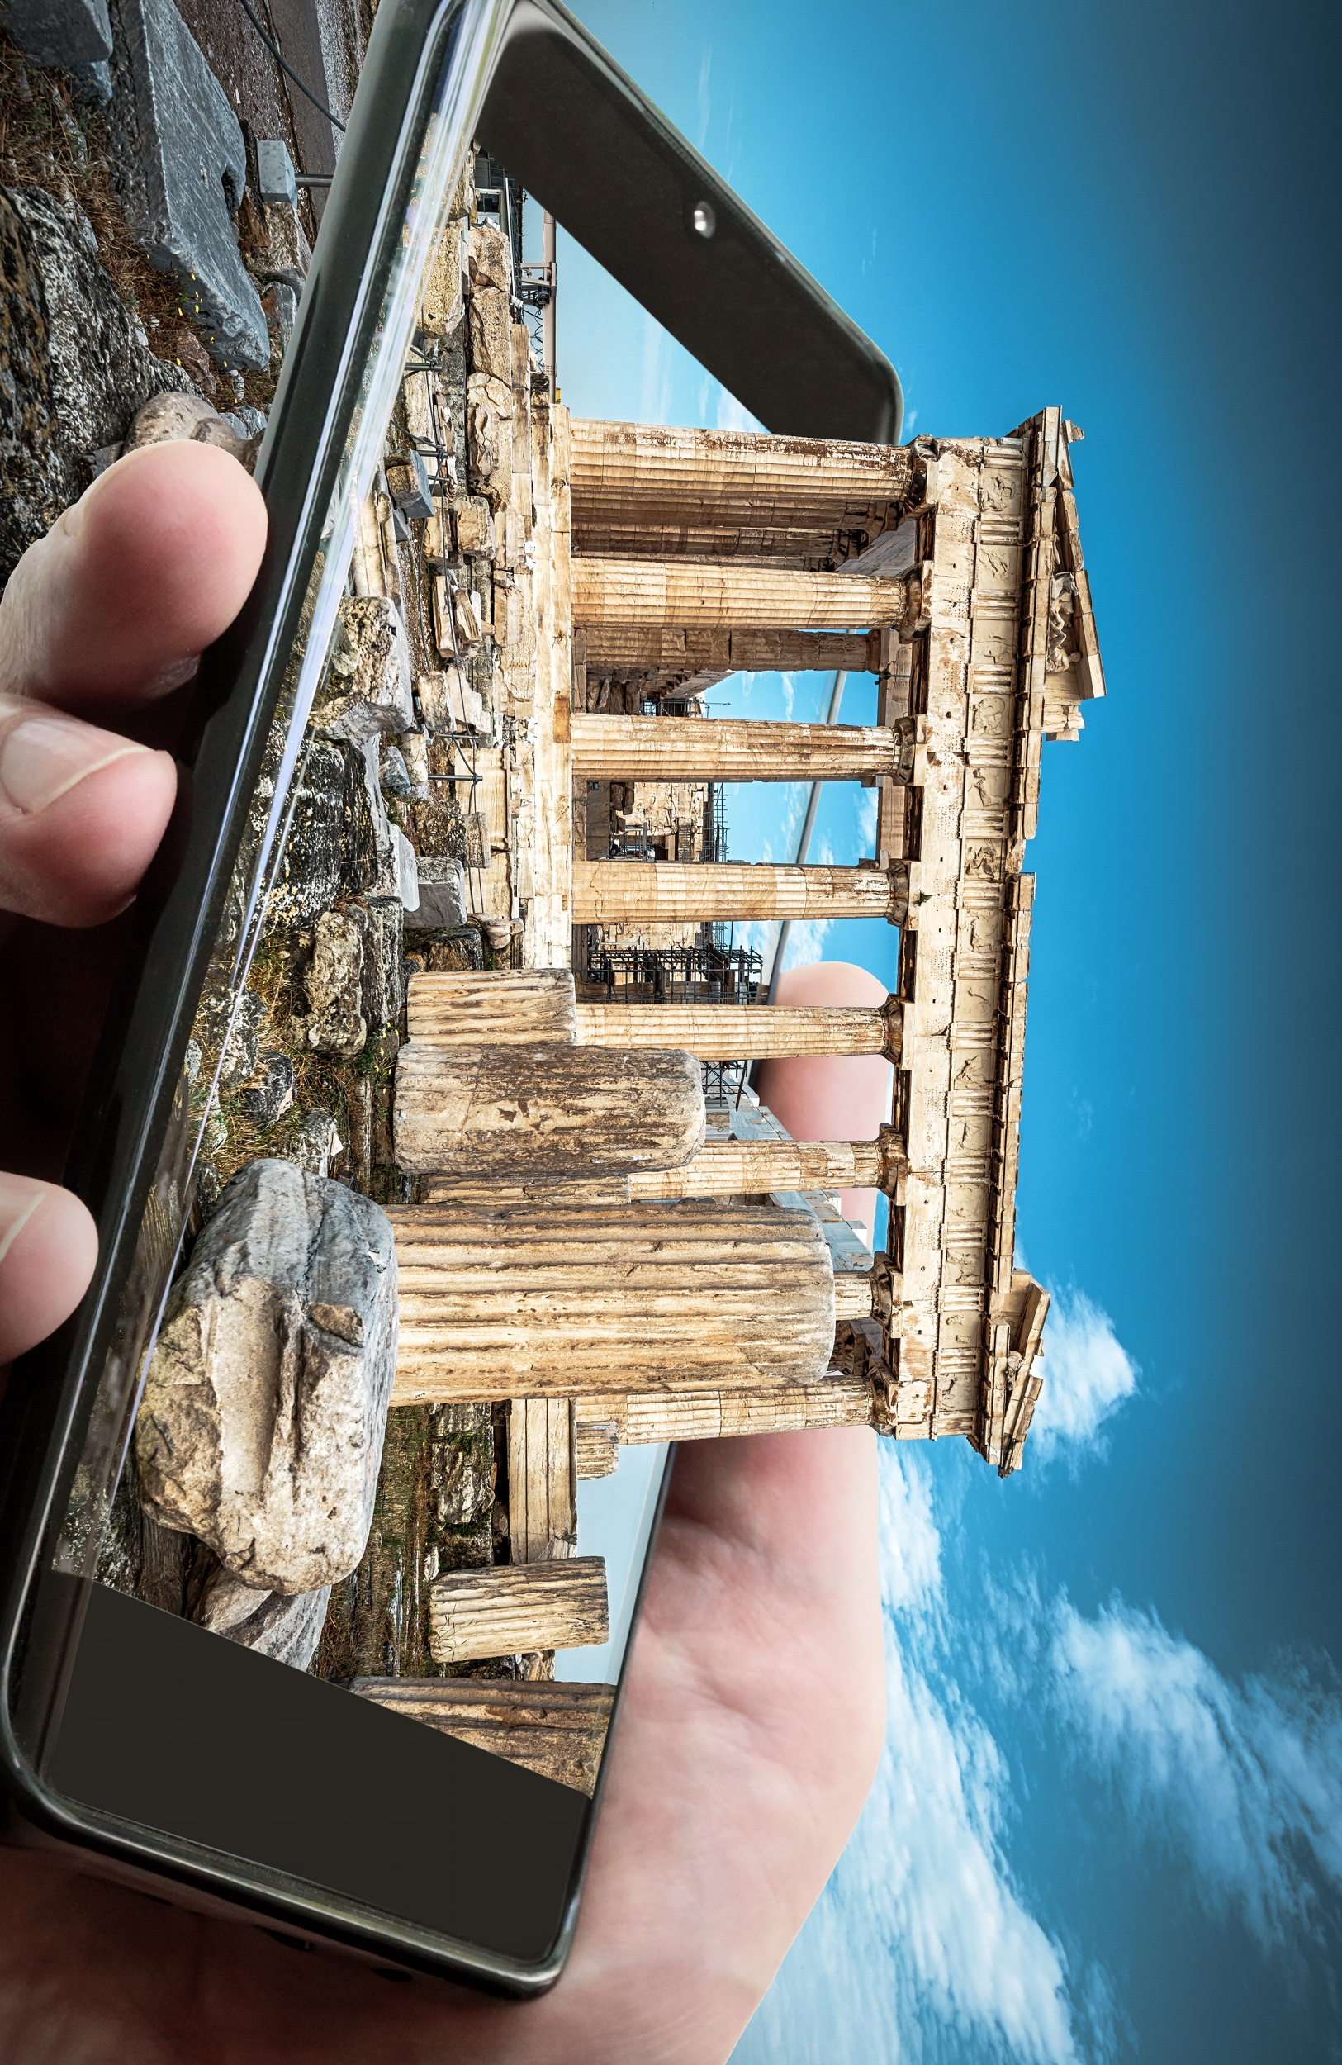
Proposed System Overview
1
Image Acquisition
capturing high-quality 2D images of the archaeological object using a mobile device.
2
Image Preprocessing
Once the images are captured, they undergo preprocessing to enhance their quality and prepare them for 3D reconstruction.
3
Feature Extraction
extract distinctive features from the preprocessed images
4
3D Model Reconstruction
the system reconstructs the 3D model of the archaeological object.
IT21344824 | T.E.M.A.P. Ekanayake | 24-25J-092
13/8/2024

Slide 11
Methodology
Technologies
Techniques
Algorithms
MongoDB
Python
Node
Azure
Real-time data collection and analysis
Programming languages (e.g., Python for machine learning).
Application Development-React native
Machine Learning Models: Regression algorithms for generate 3D object
IT21344824 | T.E.M.A.P. Ekanayake | 24-25J-092
13/8/2024

Slide 12
Completion of the project
Data Collection for the project is being carried out using the following ways:
Public data sets
Previous researches
Surveys
From Archaeological department
IT21344824 | T.E.M.A.P. Ekanayake | 24-25J-092
13/8/2024

Slide 13
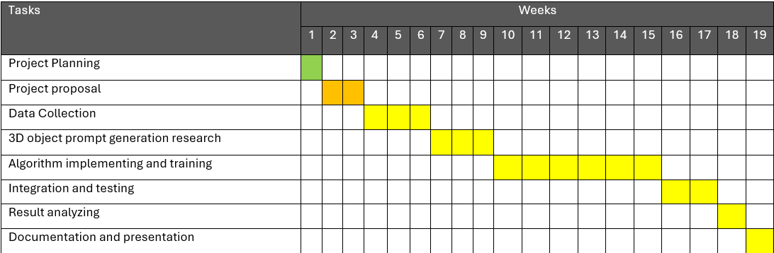
Gannt Chart
IT21344824 | T.E.M.A.P. Ekanayake | 24-25J-092
13/8/2024

Slide 14
Requirements
Non-functional requirements
System requirements
Performance
Reliability
Scalability
Security
Usability
Maintainability
Accuracy
Hardware: Mobile device with a high-resolution camera and sufficient processing power
Software: Operating System: Android 9.0 or higher, iOS 12.0 or higher.
functional requirements
Algorithm Development : Develop algorithms to accurately convert 2D images into 3D models.
Mobile Optimization : Optimize the 3D object generation process for mobile devices.
Integration with image Scanning systems.
IT21344824 | T.E.M.A.P. Ekanayake | 24-25J-092
13/8/2024

Slide 15
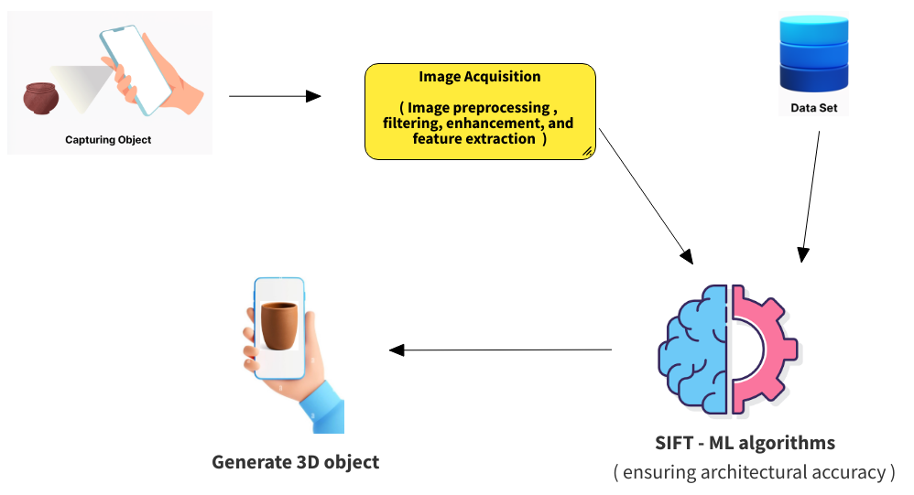

System diagram
IT21344824 | T.E.M.A.P. Ekanayake | 24-25J-092
13/8/2024

Slide 16
References
[1] X. Liu, "Research on 3D Object Reconstruction Method based on Deep Learning," in *Proceedings of the 2nd International Conference on Artificial Intelligence and Computer Engineering (ICAICE)*, Tianjin, China, Dec. 2022, pp. 93-98, doi: 10.1109/ICAICE57299.2022.00024.
[2] K. SusheelKumar, V. B. Semwal, S. Prasad, and R. C. Tripathi, "Generating 3D Model Using 2D Images of an Object," International Journal of Engineering Science and Technology (IJEST), vol. 3, no. 1, pp. 406-409, Jan. 2011.
[3] K. Zhao and A. Larsen, “Challenges and Opportunities in 3D Content Generation,” arXiv preprint arXiv:2405.15335v1, May 2024. Available: https://arxiv.org/abs/2405.15335.
[4] H. Li, Y. Zheng, X. Wu, and Q. Cai, "3D Model Generation and Reconstruction Using Conditional Generative Adversarial Network," *International Journal of Computational Intelligence Systems*, vol. 12, no. 2, pp. 697–705, 2019, doi: 10.2991/ijcis.d.190617.001.
IT21344824 | T.E.M.A.P. Ekanayake | 24-25J-092
13/8/2024

Slide 17

IT21352294 | J.R.K.B. Jayawardhana
Specialization : Information Technology
IT21352294 | J.R.K.B. Jayawardhana | 24-25J-092
13/8/2024

Slide 18
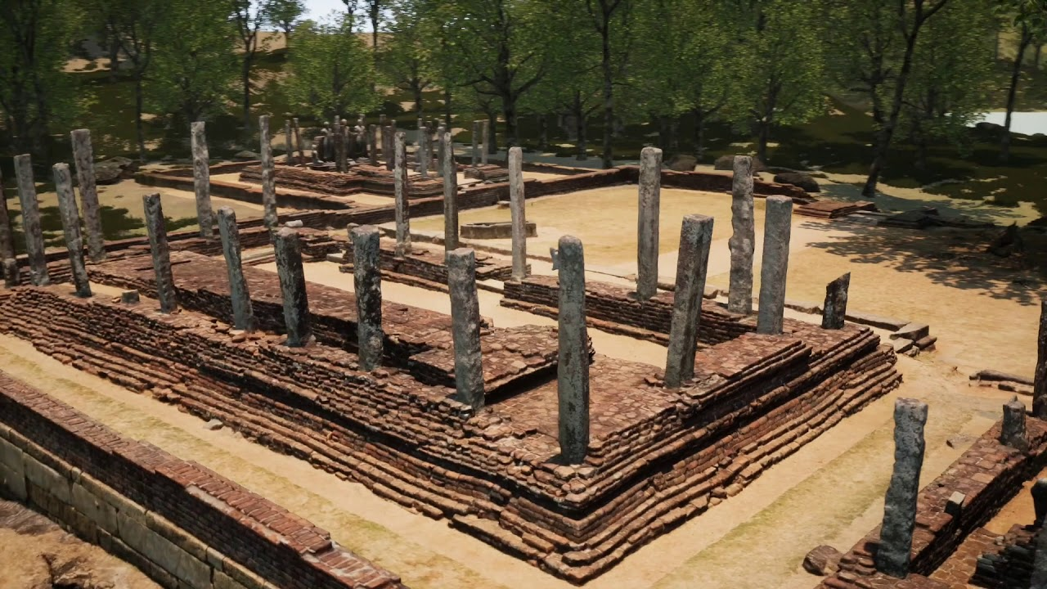
Model training and Historical Data Retrieval for objects
IT21352294 | J.R.K.B. Jayawardhana | 24-25J-092
13/8/2024

Slide 19
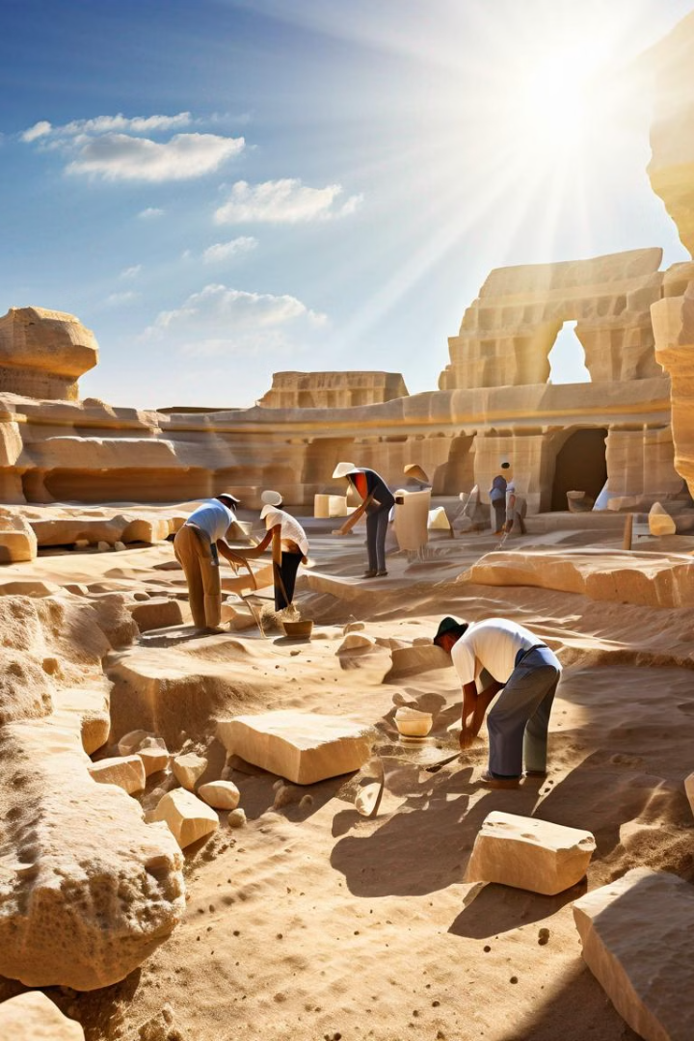
Introduction
Comprehensive Dataset Collection: Curate a specialized dataset of archaeological objects, capturing unique features for high-quality model training.
Machine Learning Model Training: Train advanced machine learning models, particularly CNNs, to accurately recognize and classify archaeological artifacts.
Historical Data Retrieval System: Implement a system to fetch relevant historical context from global databases, ensuring accurate and up-to-date information. Collect data from the Kingdoms of Sri Lanka.
API Development and Continuous Updates: Develop an API for mobile app integration and continuously update models with new data for accuracy and relevance.
IT21352294 | Jayawardhana J.R.K.B | 24-25J-092
13/8/2024

Slide 20
Introduction - Background
Challenges:
Quality and Variety - Solution: Collaborate with institutions and use advanced image processing.
Model Accuracy and Generalization - Solution: Apply transfer learning, cross-validation, and regular updates.
Integrating Historical Databases - Solution: Develop a standardized API and use data normalization.
Continuous Model Improvement - Solution: Establish a feedback loop and automate retraining.
IT21352294 | J.R.K.B . Jayawardhana | 24-25J-092
13/8/2024

Slide 21
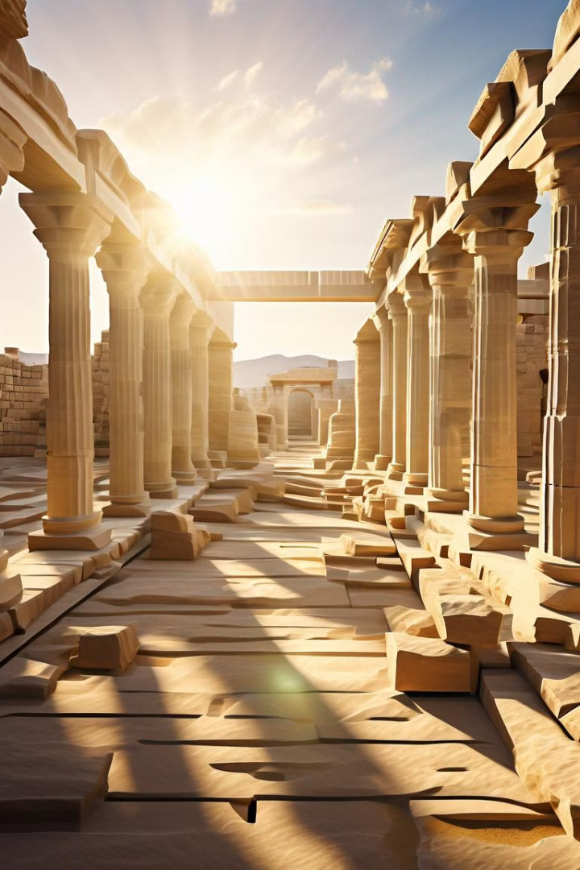
Research Gap
Research Area | Identified Gap
Availability of Annotated Data | Limited annotated datasets specific to the Anuradhapura Kingdom.
Integration of Multimodal Data | Lack of integration of visual and textual data.
Representation of Minor Artifacts | Minor artifacts are underrepresented in research.
IT21352294 | J.R.K.B. Jayawardhana | 24-25J-092
13/8/2024

Slide 22
Research Question
How can machine learning and historical data integration improve the accuracy and contextual understanding of archaeological object recognition?
IT21352294 | J.R.K.B. Jayawardhana | 24-25J-092
13/8/2024

Slide 23
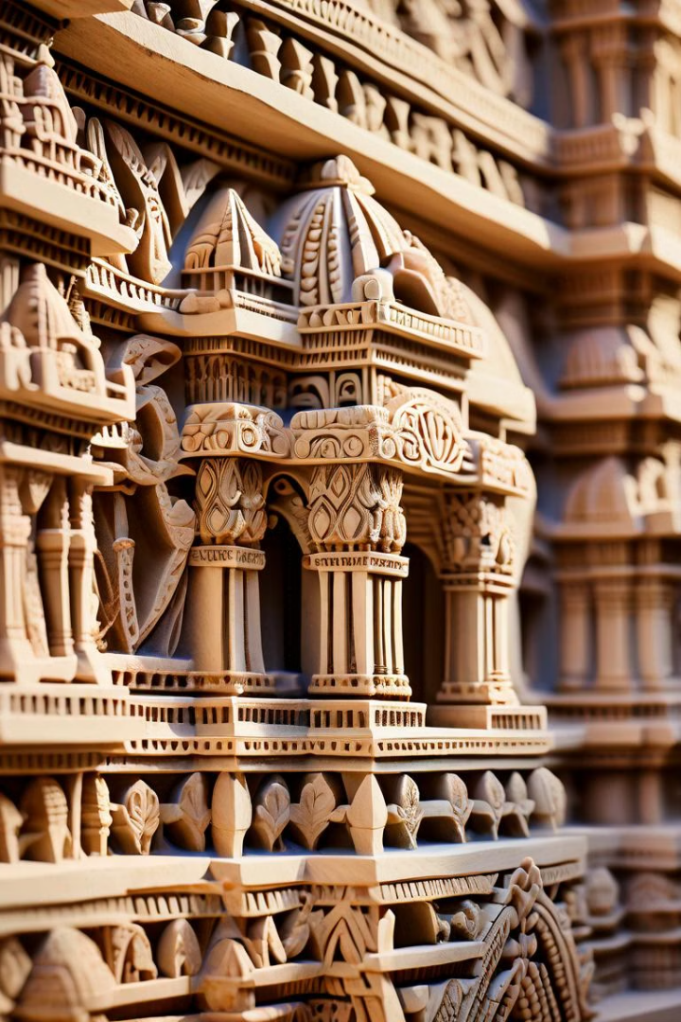
Specific & Sub Objectives
Specific Objective
To create and refine a machine learning model that accurately detects and predicts object features using historical data, ensuring efficient data retrieval and continuous model enhancement.
Sub Objective
Enhance Data Quality: Preprocess and annotate historical data to improve the accuracy of model training.
Optimize Model Algorithms: Select and fine-tune algorithms for better feature detection and prediction.
Efficient Data Retrieval: Develop a system for quick and accurate retrieval of historical data to support model predictions and user needs
IT21352294 | J.R.K.B. Jayawardhana | 24-25J-092
13/8/2024

Slide 24
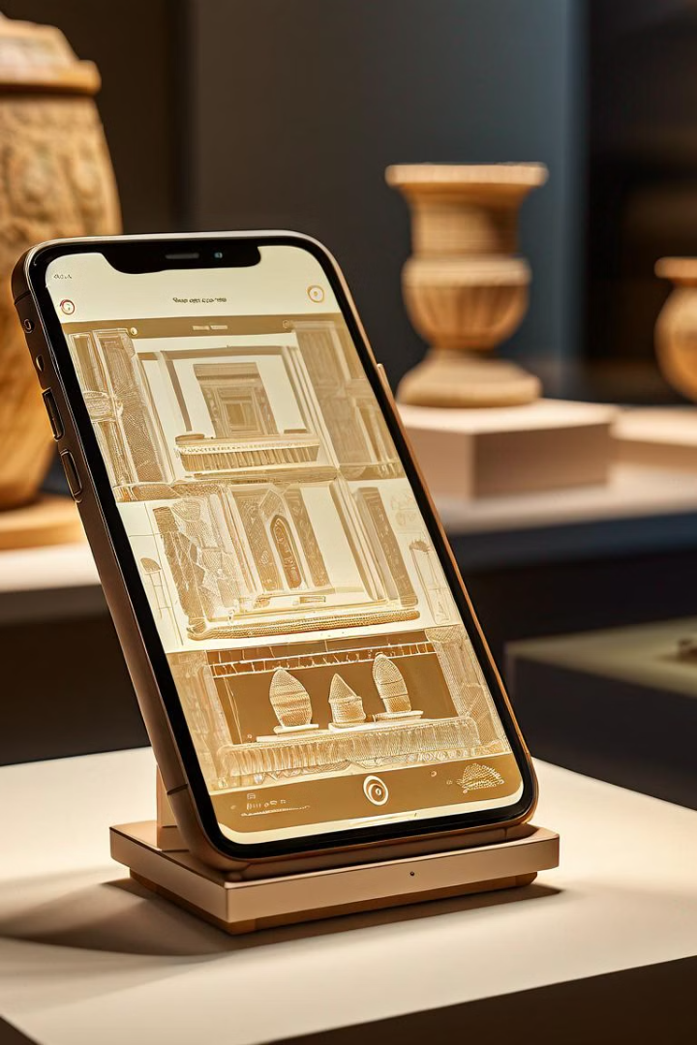
Proposed System Overview
1
Data Collection
Historical data related to the objects is gathered from various sources.
2
Data Preprocessing
Collected data is cleaned and processed to remove noise and inconsistencies.
3
Model Training
Machine learning models are trained using the processed historical data
to identify patterns and make predictions.
4
Data Retrieval & Output
The system retrieves relevant historical data and presents it for analysis or further use.
IT21352294 | J.R.K.B. Jayawardhana | 24-25J-092
13/8/2024

Slide 25
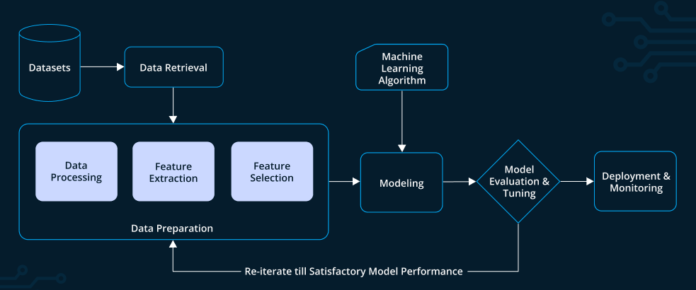
System Diagram
IT21352294 | J.R.K.B. Jayawardhana | 24-25J-092
13/8/2024

Slide 26
Methodology
Technologies and Techniques
1. Data Collection and Preprocessing
Gather and preprocess images and textual descriptions of Anuradhapura artifacts.
2. Multimodal Data Integration
Combine images and textual data into a unified system.
3. Model Training
Train deep learning models to recognize and classify artifacts.
4. Historical Data Retrieval
Retrieve and present contextual and temporal data about artifacts.
Data Collection and Preprocessing
Technique: Labelbox for annotation and organization of artifact images and metadata.
Multimodal Data Integration
Technology: Azure for storing and managing multimodal data, linking images with textual descriptions.
Model Training
Technology: TensorFlow for building and training deep learning models to recognize and classify artifacts.
Historical Data Retrieval
Technology: Elasticsearch for efficient search and retrieval of historical data, including temporal context.
IT21352294 | J.R.K.B. Jayawardhana | 24-25J-092
13/8/2024

Slide 27
Completion of the project
Data Collection for the project is being carried out using the following ways:
Public data sets
Previous researches
Surveys
From Archaeological department
IT21352294 | J.R.K.B. Jayawardhana | 24-25J-092
13/8/2024

Slide 28
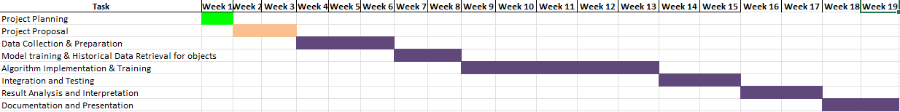
Gannt Chart
IT21352294 | J.R.K.B. Jayawardhana | 24-25J-092
13/8/2024

Slide 29
Requirements
System requirements
Hardware: Intel Core i7/Ryzen 7, NVIDIA RTX 3060, 16 GB RAM, 512 GB SSD (primary), 256 GB SSD/external/cloud storage (secondary), reliable internet (50 Mbps)
Software: Windows/macOS/Linux, Python 3.x, TensorFlow/PyTorch, Jupyter Notebook, SQLite/PostgreSQL, RESTful APIs, Git.
Non-functional requirements
Performance
Reliability
Scalability
Security
Usability
Maintainability
Accuracy
functional requirements
User Interface: Intuitive UI for data input, training, and results visualization.
Data Management: Efficient storage with lightweight databases and data compression.
.
IT21352294 | J.R.K.B. Jayawardhana | 24-25J-092
13/8/2024

Slide 30
References
[1] A. Wijesuriya and S. G. Ranawana, "Building a comprehensive digital heritage archive for the Anuradhapura Kingdom of Sri Lanka," Journal of Archaeological Science, vol. 58, pp. 45-55, 2020.
[2] M. K. Jayawardene, T. Gunaratne, and H. W. Senanayake, "Multimodal archaeological data integration: A case study on the Anuradhapura Kingdom," Journal of Cultural Heritage, vol. 24, pp. 223-232, 2021. [3] P. S. Kumara and N. G. Pathirana, "Revisiting the Anuradhapura Kingdom: The importance of minor artifacts in archaeological research," International Journal of Archaeology, vol. 12, no. 4, pp. 275-288, 2021.
IT21352294 | J.R.K.B. Jayawardhana | 24-25J-092
13/8/2024

Slide 31

IT21273094 | Ediriwickrama E.A.K.V.
Specialization : Information Technology
IT21273094 | Ediriwickrama E.A.K.V. | 24-25J-092
13/8/2024

Slide 32
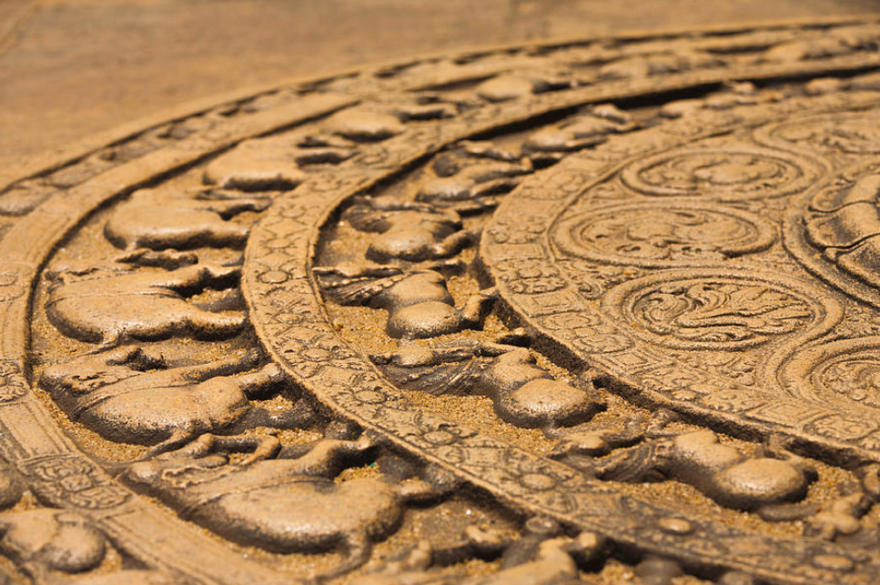
Feature Detection in Archaeological Objects
IT21273094 | Ediriwickrama E.A.K.V. | 24-25J-092
13/8/2024

Slide 33
Introduction
The process of identifying and extracting key features or points of interest in images of archaeological objects.
Inscriptions, carvings, and structural designs are crucial in understanding the historical and cultural contexts of ancient civilizations.
Challenges
Time-Consuming & Error-Prone: Traditional methods are labor-intensive and can result in inaccuracies.
Accessibility Issues: Specialized equipment and expertise are often required, limiting who can document these features.
IT21273094 | Ediriwickrama E.A.K.V. | 24-25J-092
13/8/2024

Slide 34
Research Gap
Current tools are not designed to identify architectural features from archaeological objects and often require documentation.
Objective: Develop a specialized mobile application that provides real-time analysis and documentation of architectural features on-site.
IT21273094 | Ediriwickrama E.A.K.V. | 24-25J-092
13/8/2024

Slide 35
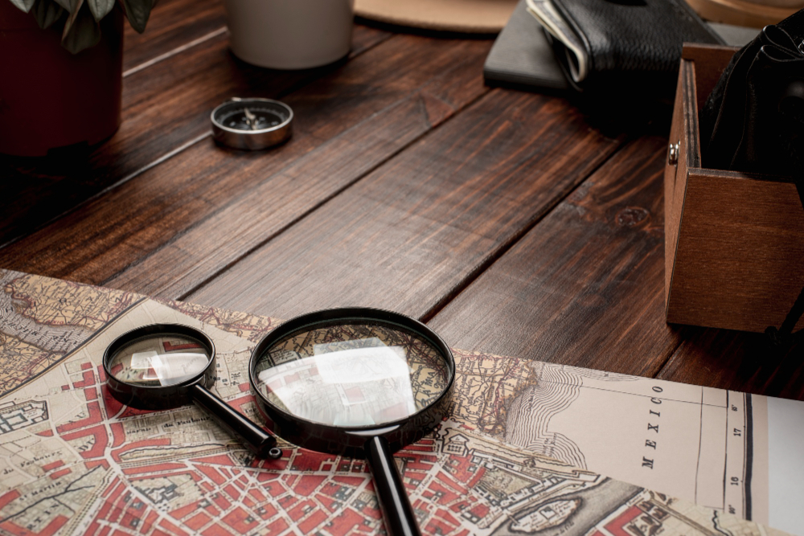
Research Question
How can develop an efficient, automated system for detecting and analyzing architectural features from archaeological objects in real-time?
IT21273094 | Ediriwickrama E.A.K.V. | 24-25J-092
13/8/2024

Slide 36
Specific & Sub Objectives
Specific Objective
Develop a mobile application that uses image processing and machine learning to detect and analyze architectural features in archaeological objects
Sub Objective
Feature Identification: Detect key architectural elements such as inscriptions, carvings, and structural designs
Image Preprocessing: Develop algorithms to handle various environmental challenges like lighting and shadowing for clearer feature detection.
Feature Analysis: Create methods for analyzing detected features and providing historical context.
IT21273094 | Ediriwickrama E.A.K.V. | 24-25J-092
13/8/2024

Slide 37
Proposed System Overview
1
Image Input:
Images captured by the mobile device’s camera
2
Image Preprocessing
Images are processed for noise reduction and enhancement.
3
Feature Detection
Key features of the objects are identified using advanced algorithms.
4
Output
The detected features are outputted for further use and Allows user interaction with the system for viewing and managing detected features.
IT21273094 | Ediriwickrama E.A.K.V. | 24-25J-092
13/8/2024

Slide 38
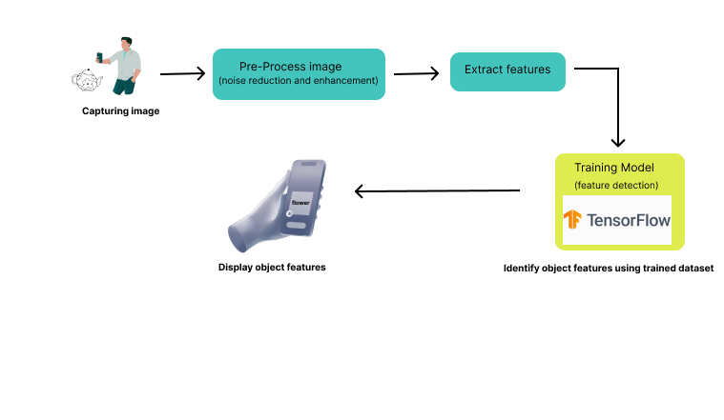
System Diagram
IT21273094 | Ediriwickrama E.A.K.V. | 24-25J-092
13/8/2024

Slide 39
Methodology
Technologies and Techniques
Data Collection and Labeling: Select and annotate images from Kaggle.
Image Preprocessing: Resize, normalize, and augment images.
CNN Model Development: Design and train a CNN model for disease classification.
Performance Evaluation: Evaluate the model's performance using metrics such as accuracy, precision, and recall.
Image Processing: OpenCV
Feature Detection: SIFT, ORB, TensorFlow
Programming Languages: Python
Mobile Integration: TensorFlow Lite for mobile deployment
Application Development-React native
Database: Firebase
IT21273094 | Ediriwickrama E.A.K.V. | 24-25J-092
13/8/2024

Slide 40
Completion of the project
Data Collection for the project is being carried out using the following ways:
Public data sets
Previous researches
Surveys
From Archaeological department
IT21273094 | Ediriwickrama E.A.K.V. | 24-25J-092
13/8/2024

Slide 41
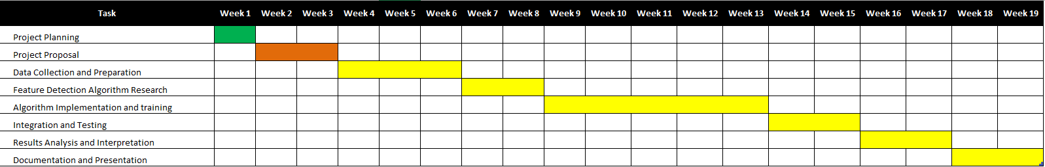
Gannt Chart
IT21273094 | Ediriwickrama E.A.K.V. | 24-25J-092
13/8/2024

Slide 42
Requirements
System requirements
Non-functional requirements
Hardware: High-resolution cameras, powerful computing resources.
Software: Feature detection and image processing tools.
Performance
Reliability
Scalability
Security
Usability
Maintainability
Accuracy
functional requirements
Capability to detect and extract features from various artifact types.
Integration with image acquisition systems.
IT21273094 | Ediriwickrama E.A.K.V. | 24-25J-092
13/8/2024

Slide 43
References
[1] M. V. Peppa et al., “ARCHAEOLOGICAL FEATURE DETECTION FROM ARCHIVE AERIAL PHOTOGRAPHY WITH a SFM-MVS AND IMAGE ENHANCEMENT PIPELINE,” the International Archives of the Photogrammetry, Remote Sensing and Spatial Information Sciences/International Archives of the Photogrammetry, Remote Sensing and Spatial Information Sciences, vol. XLII–2, pp. 869–875, May 2018, doi: 10.5194/isprs-archives-xlii-2-869-2018.
[2] M. Altaweel, A. Khelifi, Z. Li, A. Squitieri, T. Basmaji, and M. Ghazal, “Automated Archaeological Feature Detection using Deep Learning on Optical UAV imagery: Preliminary results,” Remote Sensing, vol. 14, no. 3, p. 553, Jan. 2022, doi: 10.3390/rs14030553.
IT21273094 | Ediriwickrama E.A.K.V. | 24-25J-092
13/8/2024

Slide 44

IT21360978 | Serasinghe G.P.G.Y.
Specialization : Information Technology
IT21360978 | Serasinghe G.P.G.Y. | 24-25J-092
13/8/2024

Slide 45
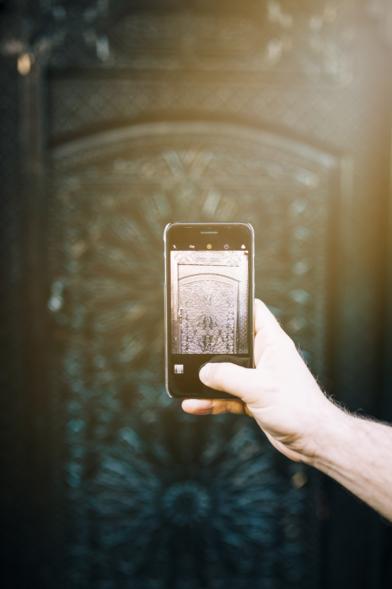
Image Acquisition and Object Recognition
IT21360978 | Serasinghe G.P.G.Y. | 24-25J-092
13/8/2024

Slide 46
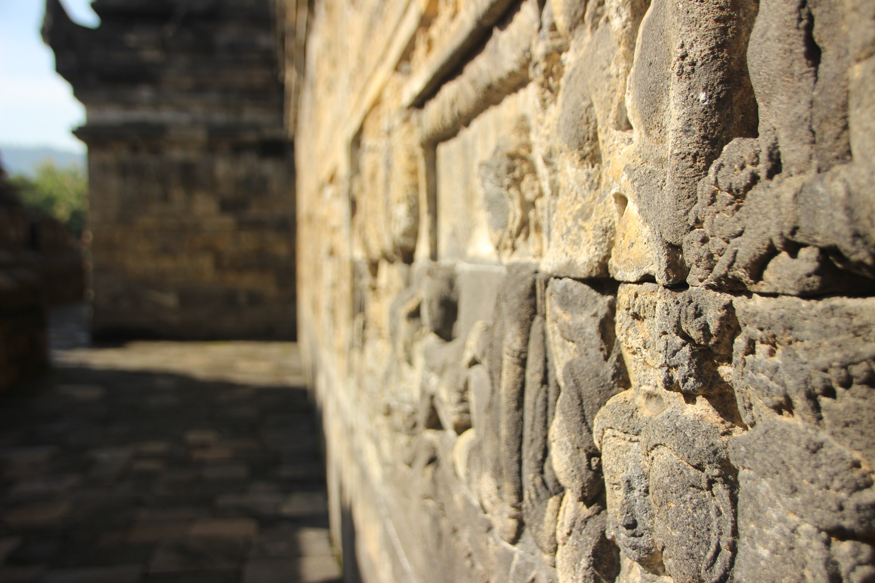
Introduction
Capturing high-quality images of archaeological objects.
Essential for detailed documentation, preservation, and analysis.
Identifying and extracting relevant data from images of archaeological objects.
Provides insights into historical and architectural significance.
Importance
Enhances the ability to study and preserve cultural heritage.
Facilitates remote analysis and collaboration among archaeologists
IT21360978 | Serasinghe G.P.G.Y. | 24-25J-092
13/8/2024

Slide 47
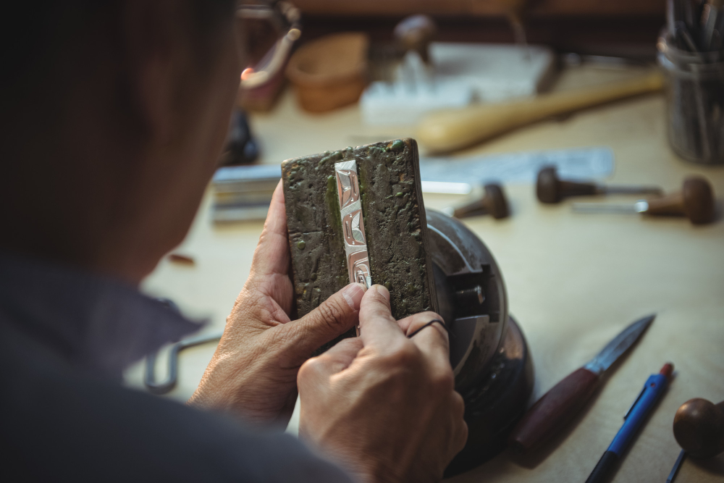
Challenges:
Quality of Images- Variability in lighting conditions and image resolution.
Complexity of Objects- Diverse shapes, textures, and materials can complicate recognition
Data Variability -Variability in the appearance of objects due to wear, age, and environmental conditions.
IT21360978 | Serasinghe G.P.G.Y. | 24-25J-092
13/8/2024

Slide 48
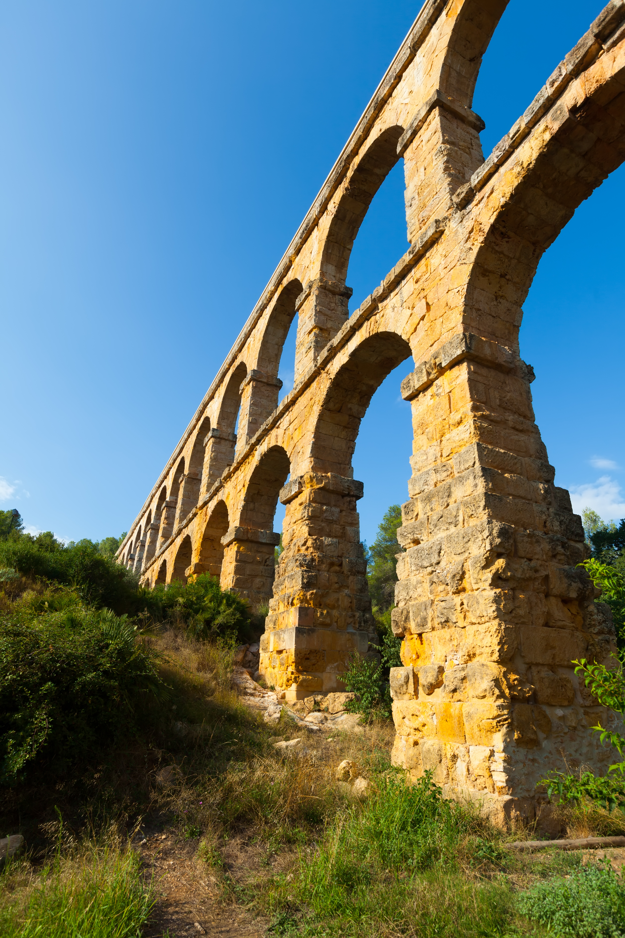
Research Gap
Existing Limitations: Current systems may not offer real-time, high-accuracy object recognition using mobile devices.
Innovation Needed: Developing a mobile application that can process images and recognize objects with high accuracy in real-time.
IT21360978 | Serasinghe G.P.G.Y. | 24-25J-092
13/8/2024

Slide 49
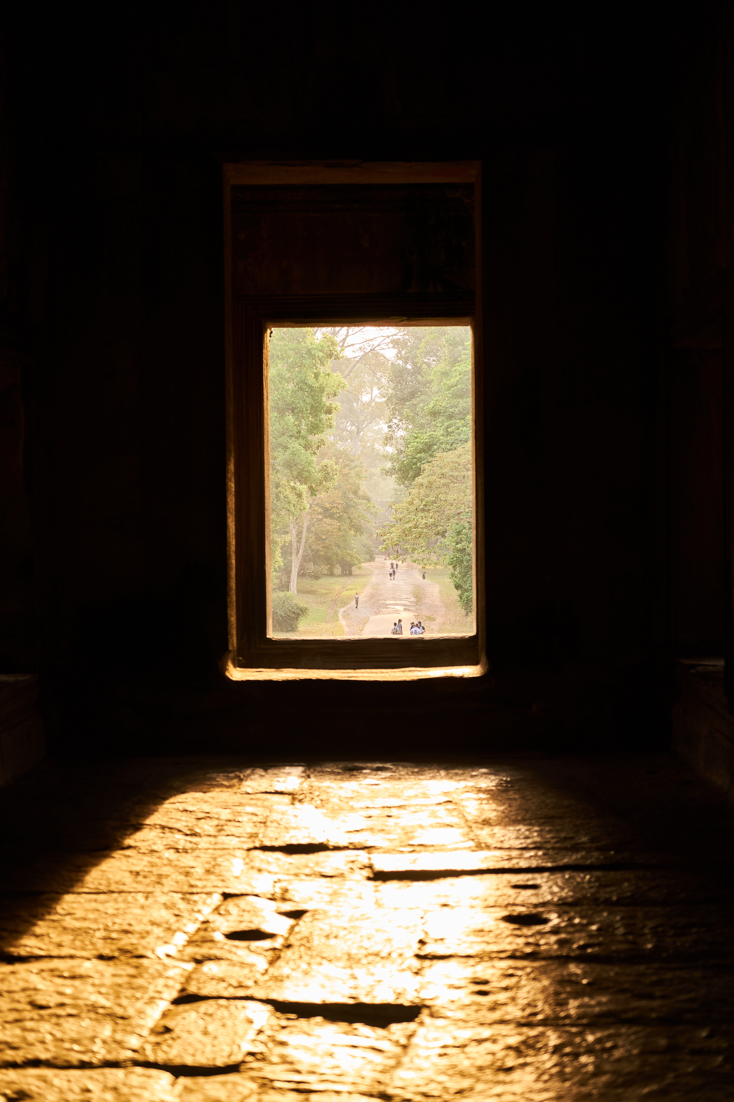
Research Question
How can advanced image acquisition and object recognition techniques be tailored to effectively identify and analyze archaeological objects?
IT21360978 | Serasinghe G.P.G.Y. | 24-25J-092
13/8/2024

Slide 50
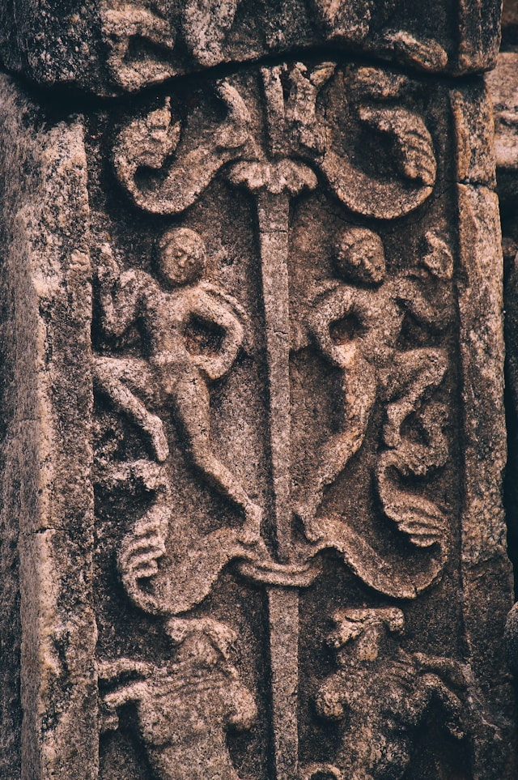
Specific & Sub Objectives
Specific Objective
To develop a system for image acquisition and object recognition specifically for archaeological artifacts.
Sub Objective
To improve image quality and consistency under different conditions.
To enhance feature detection accuracy for diverse object types.
To integrate recognition algorithms with historical data for contextual analysis.
IT21360978 | Serasinghe G.P.G.Y. | 24-25J-092
13/8/2024

Slide 51
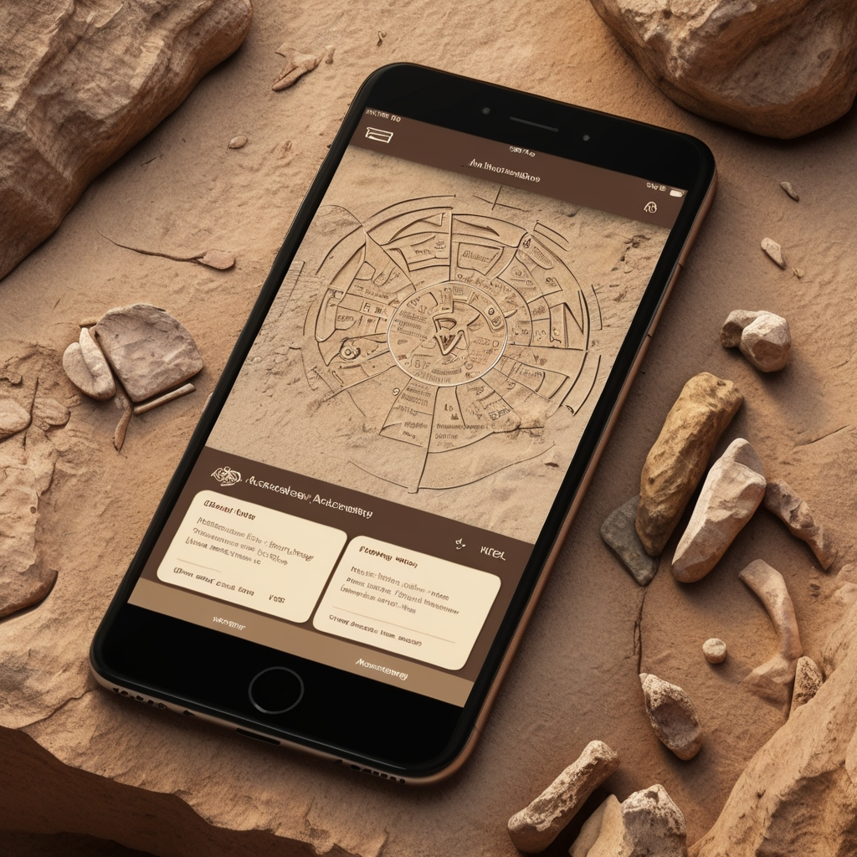
Proposed System Overview
1
Image Acquisition
capturing high-quality 2D images of the archaeological object using a mobile device.
2
Image Preprocessing
Images are processed for noise reduction and enhancement..
3
Object Recognition
Key features of the objects are identified using advanced algorithms.
4
Output:
The detected objects are outputted for further use and allow user interaction with the system for viewing and managing detected objects.
IT21360978 | Serasinghe G.P.G.Y. | 24-25J-092
13/8/2024

Slide 52
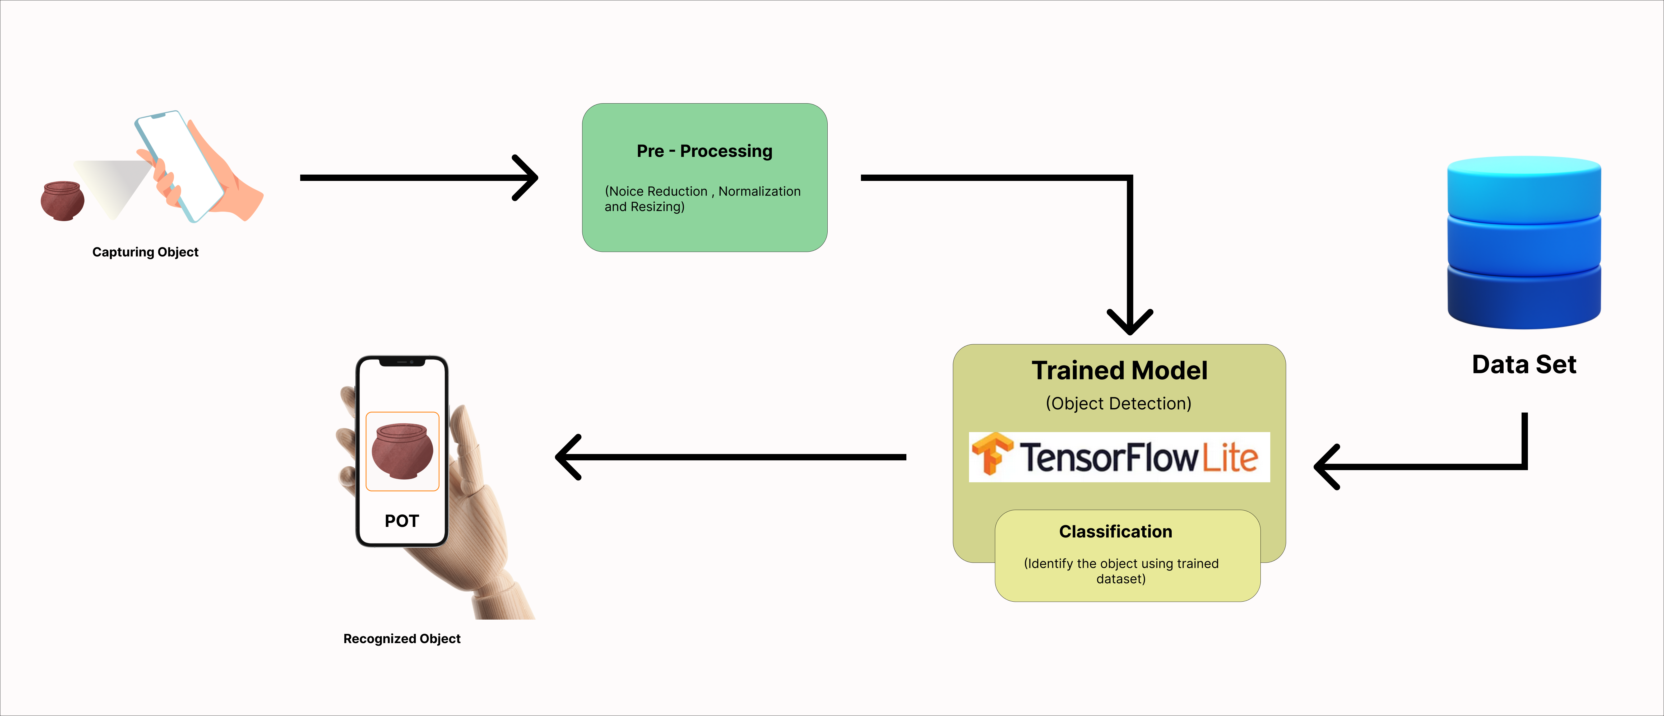
System Diagram
IT21360978 | Serasinghe G.P.G.Y. | 24-25J-092
13/8/2024

Slide 53
Methodology
Technologies and Techniques
Data Collection: Capture images using mobile devices in various environmental conditions.
Algorithm Development: Implement and test image preprocessing, and object recognition algorithms.
Model Training: Train machine learning models using a dataset of archaeological objects.
Validation: Validate the system using a test set of images to ensure accuracy and reliability.
Programming languages (e.g., Python for machine learning).
Frameworks and libraries (e.g., TensorFlow, OpenCV).
Mobile Integration: TensorFlow Lite for mobile deployment
Application Development-React native
IT21360978 | Serasinghe G.P.G.Y. | 24-25J-092
13/8/2024

Slide 54
Completion of the project
Data Collection for the project is being carried out using the following ways:
Public data sets
Previous researches
Surveys
From Archaeological department
IT21360978 | Serasinghe G.P.G.Y. | 24-25J-092
13/8/2024

Slide 55
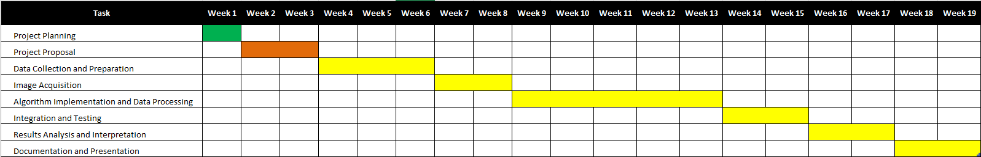
Gannt Chart
IT21360978 | Serasinghe G.P.G.Y. | 24-25J-092
13/8/2024

Slide 56
Requirements
System requirements
Non-functional requirements
Hardware: High-resolution cameras, powerful computing resources.
Software: Image processing and machine learning tools.
Performance
Reliability
Scalability
Security
Usability
Maintainability
Accuracy
functional requirements
Ability to capture and process images.
Accurate identification and classification of objects.
IT21360978 | Serasinghe G.P.G.Y. | 24-25J-092
13/8/2024

Slide 57
References
[1] “Object Detection Using Deep Learning, CNNs and Vision Transformers: A review,” IEEE Journals & Magazine | IEEE Xplore, 2023. https://ieeexplore.ieee.org/document/10098596
[2] R. Kaur and S. Singh, “A comprehensive review of object detection with deep learning,” Digital Signal Processing, vol. 132, p. 103812, Jan. 2023, doi: 10.1016/j.dsp.2022.103812.
[3] “Image recognition using machine learning techniques,” IEEE Conference Publication | IEEE Xplore, Sep. 14, 2023. https://ieeexplore.ieee.org/abstract/document/10303370
IT21360978 | Serasinghe G.P.G.Y. | 24-25J-092
13/8/2024

Slide 58
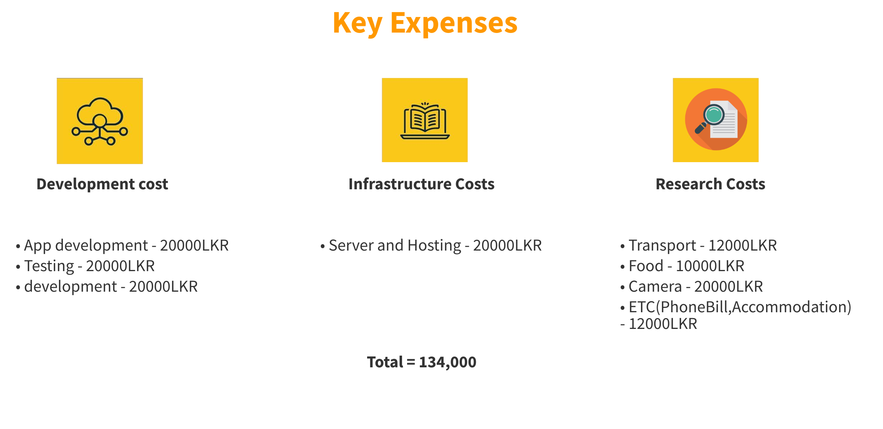
Budgeting

Slide 59
Thank you

